Slide 1
Adapted from
Wireless Communications
Principles & Practice
By Theodore S. Rappaport , 2nd ed.
Prentice Hall, 2002

Slide 2
Ch. 1 Introduction to wireless Communications Systems
In 1897, Guglielmo Marconi first demonstrated radio’s ability to provide continuous contact with ships sailing the English channel.
During the past 10 years, fueled by
  Digital and RF circuit fabrication improvements
  New VLSI technologies
  Other miniaturization technologies
    (e.g., passive components)
  The mobile communications industry has grown by orders of magnitude.
The trends will continue at an even greater pace during the next decade.
1

Slide 3
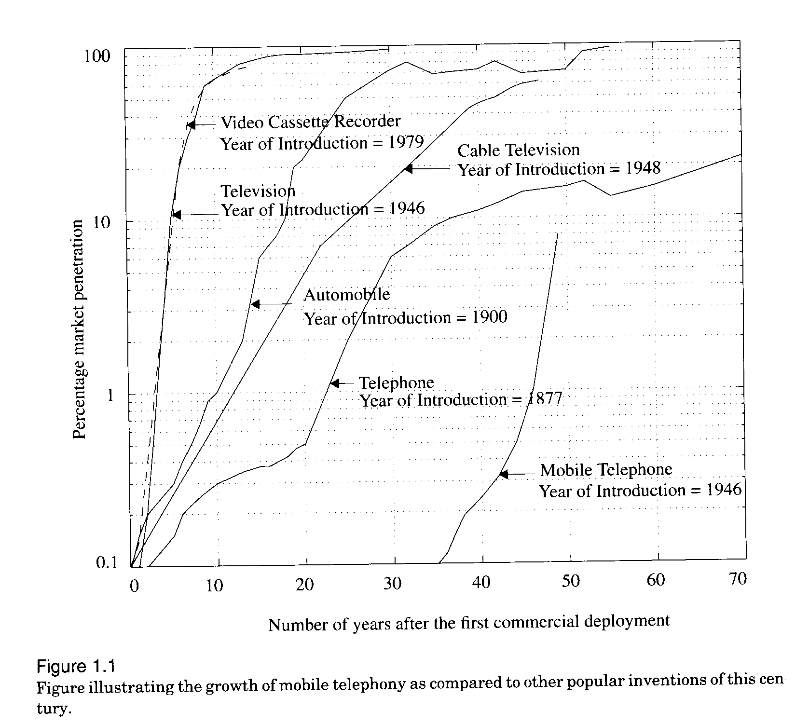
1.1 Evolution of Mobile Radio Communications

Slide 4
1.2 Mobile Radiotelephone in the U.S.
In 1934, AM mobile communication systems for municipal police radio systems.
  vehicle ignition noise was a major problem.
In 1946, FM mobile communications for the first public mobile telephone service
  Each system used a single, high-powered transmitter and large tower to cover distances of over 50 km.
  Used 120 kHz of RF bandwidth in a half-duplex mode. (push-to-talk release-to-listen systems.)
  Large RF bandwidth was largely due to the technology difficulty (in mass-producing tight RF filter and low-noise, front-end receiver amplifiers.)
In 1950, the channel bandwidth was cut in half to 60kHZ due to improved technology.

Slide 5
By the mid 1960s, the channel bandwidth again was cut to 30 kHZ.
Thus, from WWII to the mid 1960s, the spectrum efficiency was improved only a factor of 4 due to the technology advancements.
Also in 1950s and 1960s, automatic channel truncking was introduced in IMTS(Improved Mobile Telephone Service.)
  offering full duplex, auto-dial, auto-trunking
  became saturated quickly
  By 1976, has only twelve channels and could only serve 543 customers in New York City of 10 millions populations.

Slide 6
Cellular radiotelephone
  Developed in 1960s by Bell Lab and others
  The basic idea is to reuse the channel frequency at a sufficient distance to increase the spectrum efficiency.
  But the technology was not available to implement until the late 1970s. (mainly the microprocessor and DSP technologies.)
In 1983, AMPS (Advanced Mobile Phone System, IS-41) deployed by Ameritech in Chicago.
  40 MHz spectrum in 800 MHz band
  666 channels (+ 166 channels), per Fig 1.2.
  Each duplex channel occupies > 60 kHz (30+30) FDMA to maximize capacity.
  Two cellular providers in each market.

Slide 7
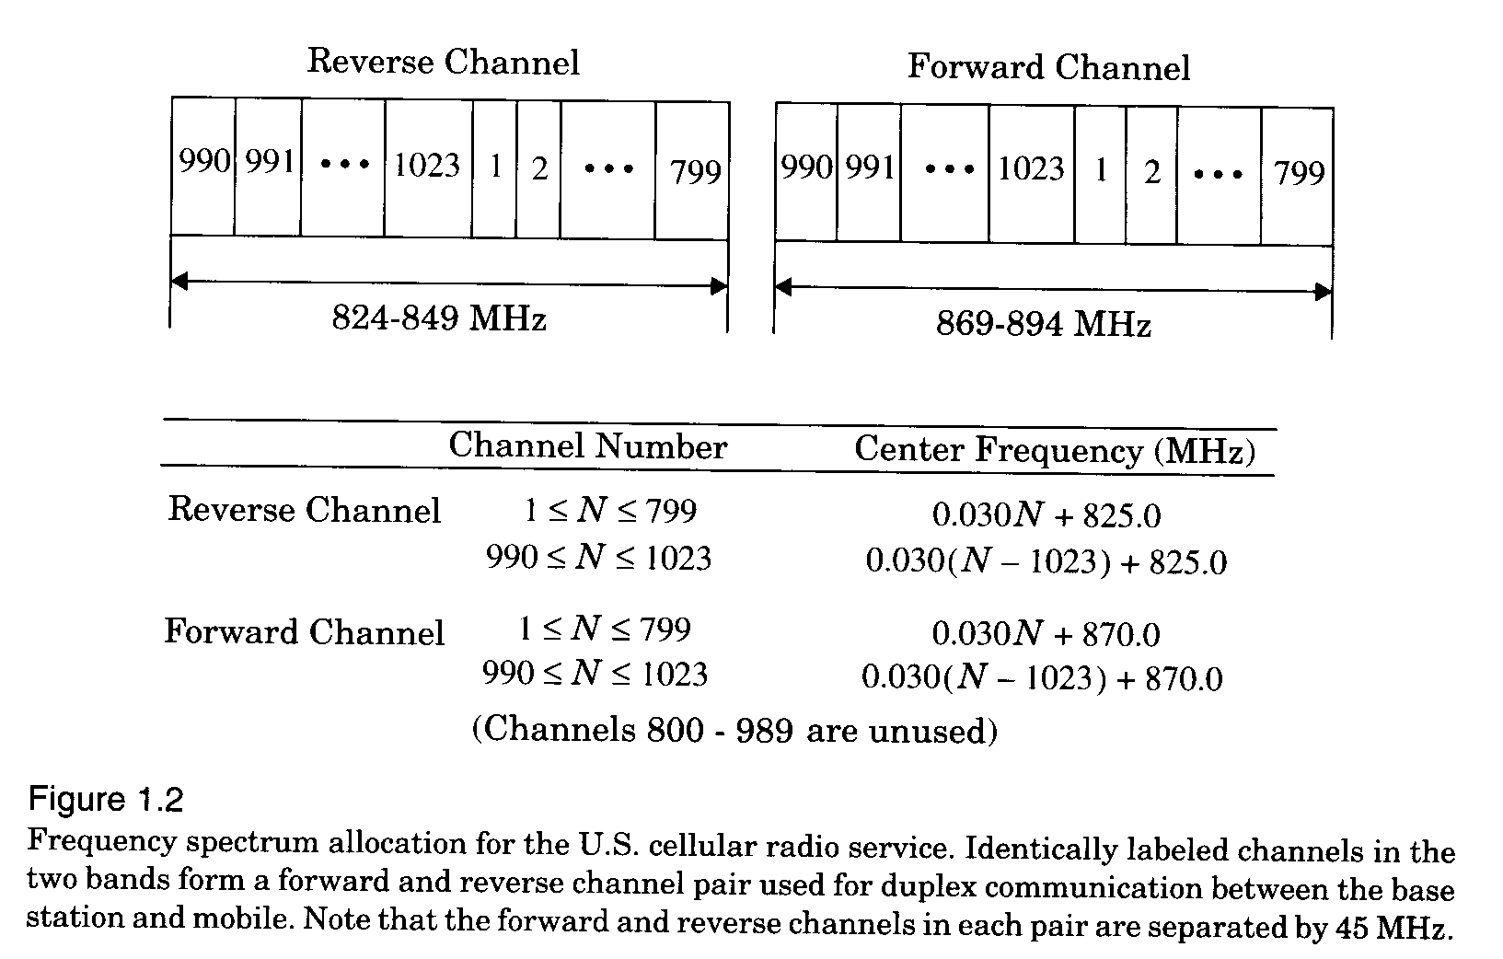

Slide 8
In late 1991, U.S. Digital Cellular (USDC, IS-54) was introduced.
  to replace AMPS analog channels
  3 times of capacity due to the use of digital modulation ( DQPSK), speech coding, and TDMA technologies.
  could further increase up to 6 times of capacity given the advancements of DSP and speech coding technologies.
In mid 1990s, Code Division Multiple Access (CDMA, IS-95) was introduced by Qualcomm.
  based on spread spectrum technology.
  supports 6-20 times of users in 1.25 MHz shared by all the channels.
  each associated with a unique code sequence.
  operate at much smaller SNR.(FdB)

Slide 9
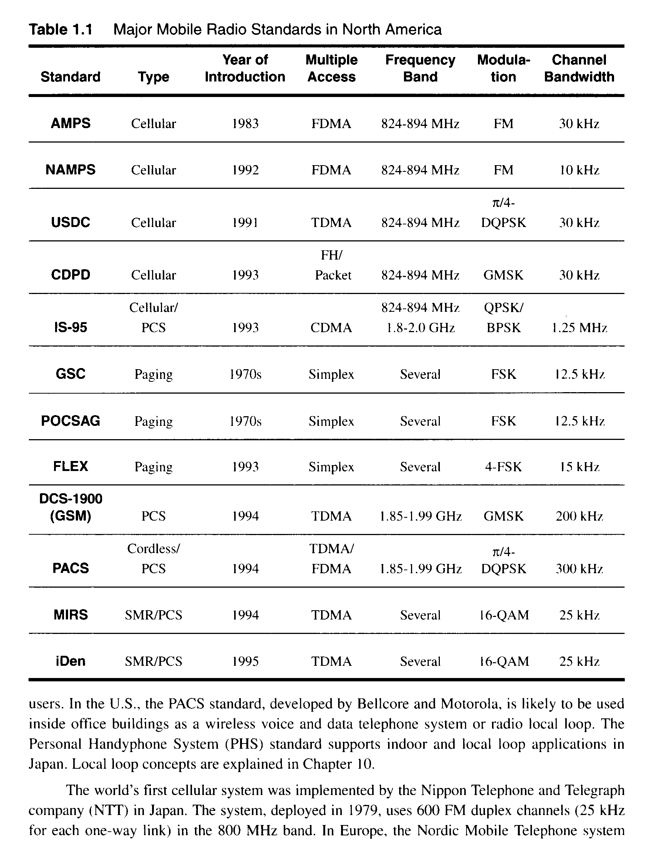

Slide 10
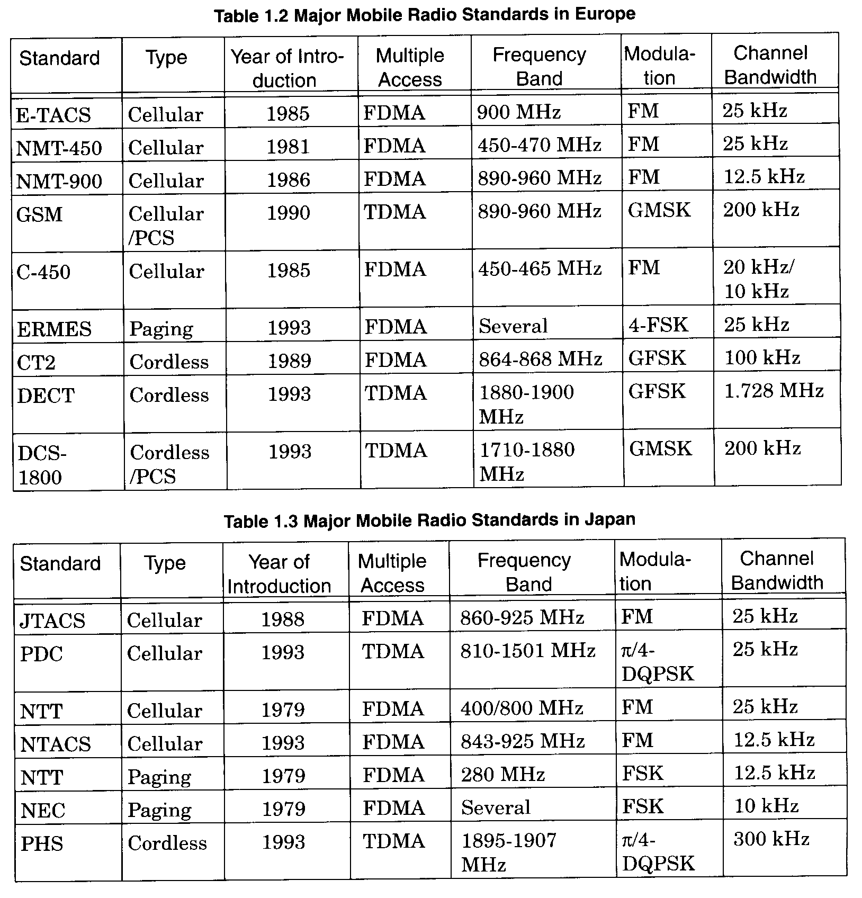
1.3 Mobile Radio Systems Around the World

Slide 11
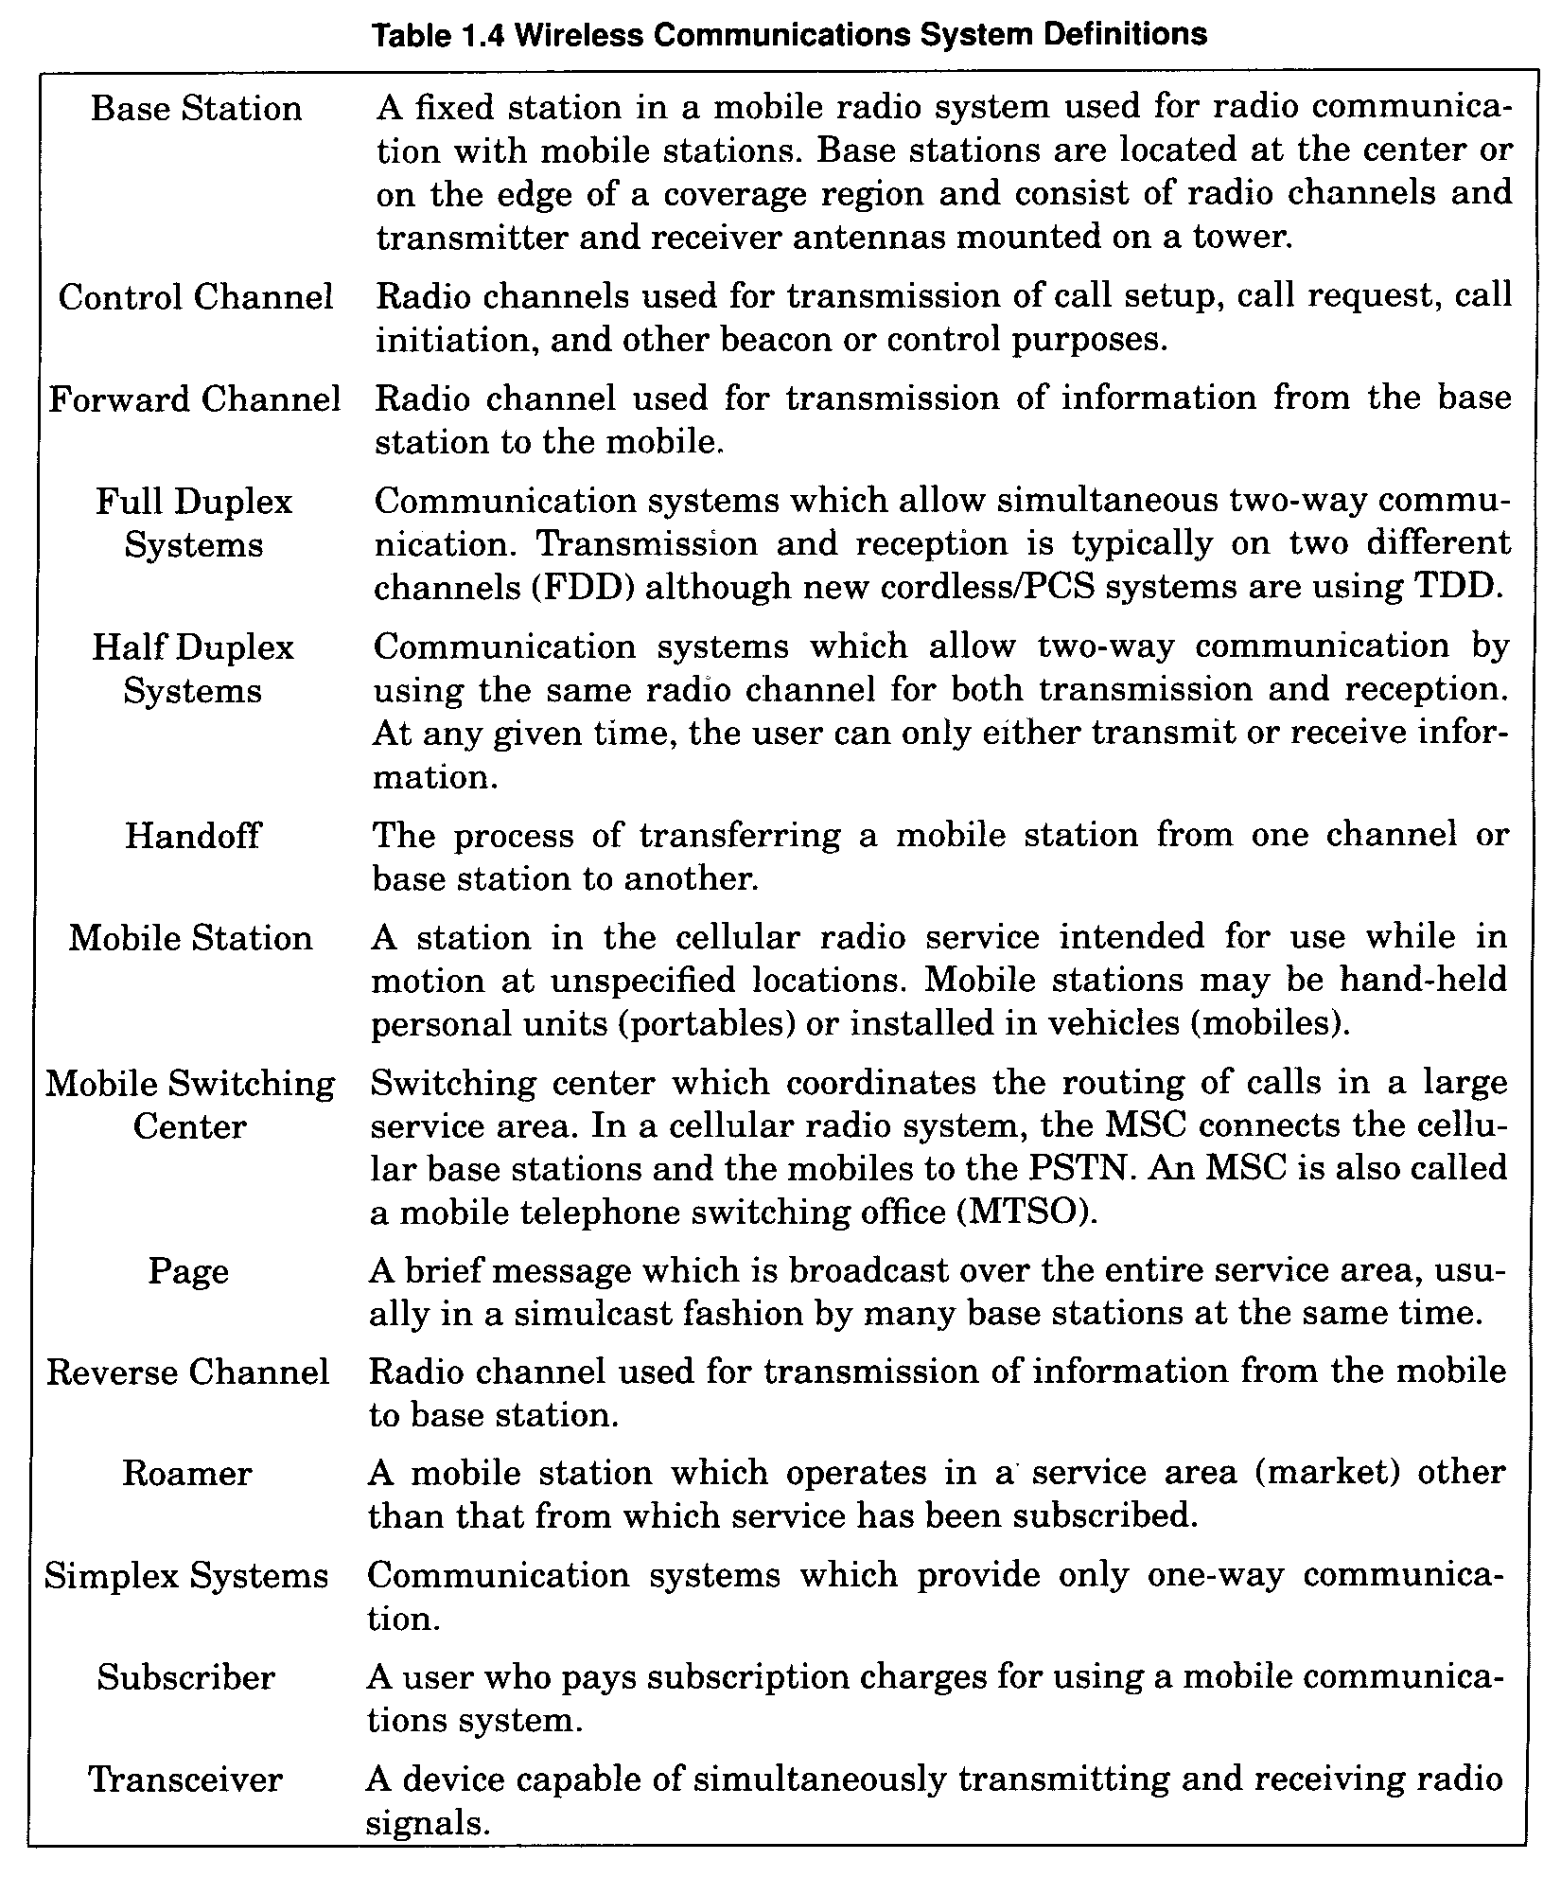
1.4 Examples of Mobile Radio Systems

Slide 12
In FDD,
  a device, called a duplexer, is used inside the subscriber unit to enable the same antenna to be used for simultaneous transmission and reception.
  to facilitate FDD, it is necessary to separate the XMIT and RCVD frequencies by about 5% of the nominal RF frequency, so that the duplexer can provide sufficient isolation while being inexpensively manufactured.
In TDD,
  only possible with digital transmission format and digital modulation.
  very sensitive to timing. Consequently, only used for indoor or small area wireless applications.

Slide 13
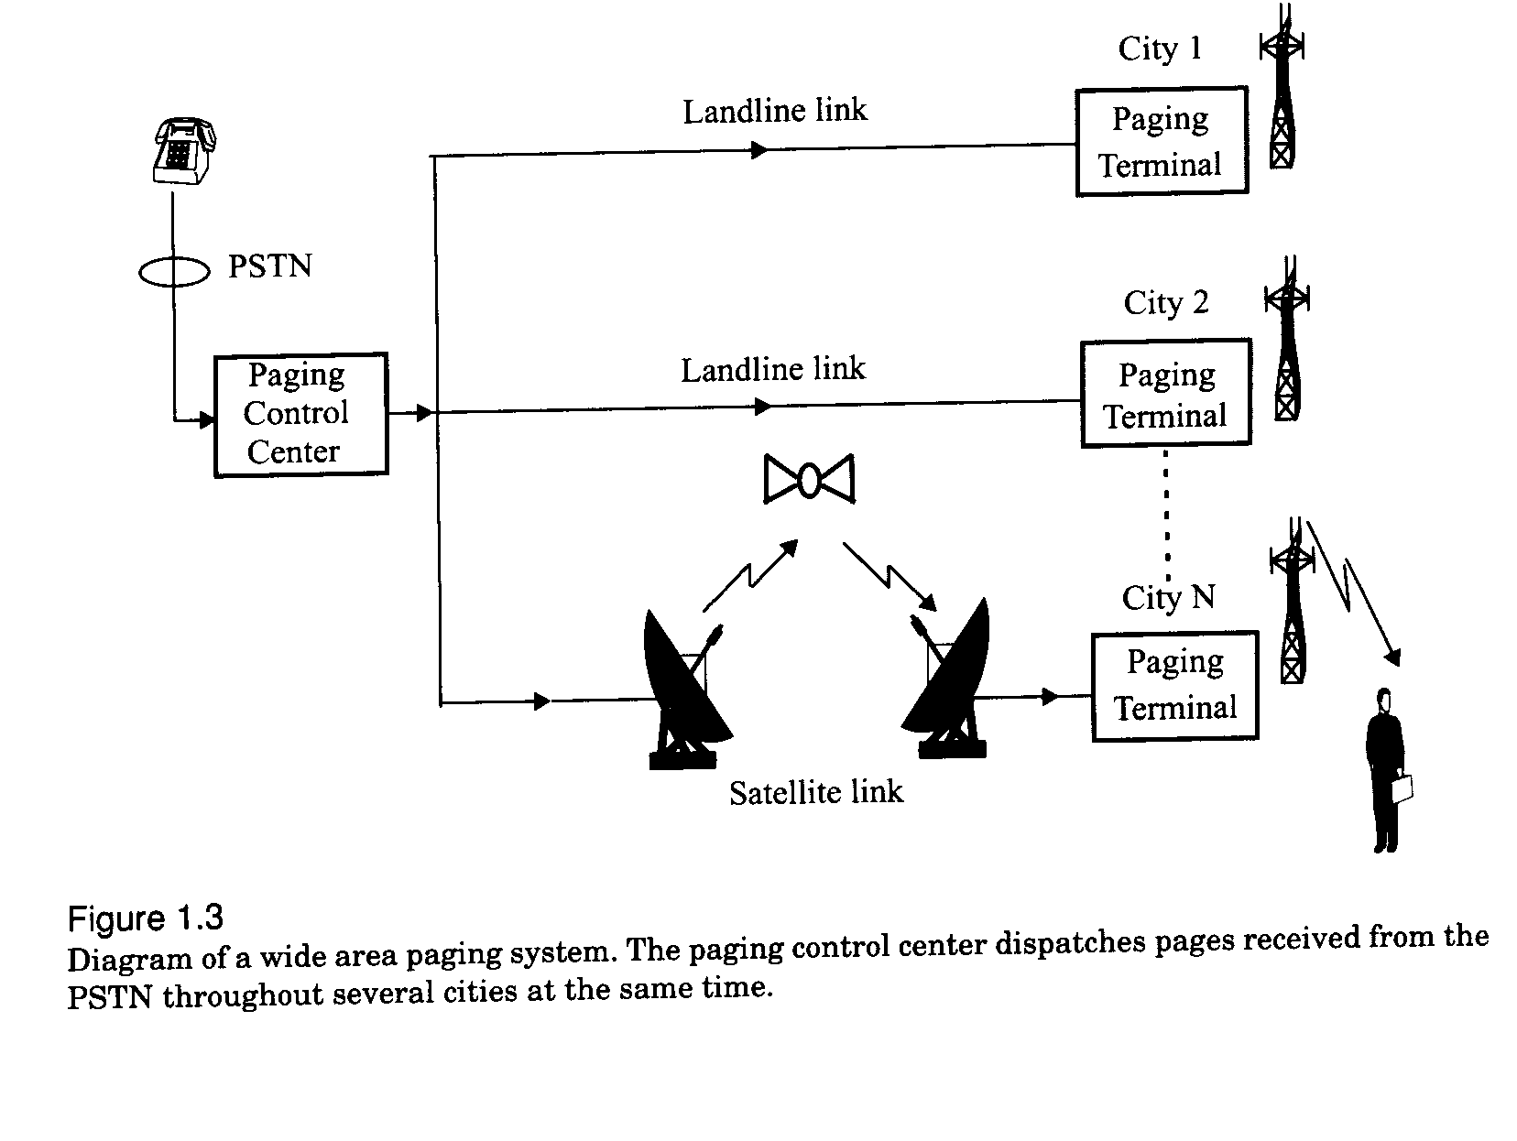
  1.4.1. Paging Systems

Slide 14
Paging receivers are simple and inexpensive, but the transmission system required is quite sophisticated. (simulcasting)
designed to provide ultra-reliable coverage, even inside buildings
Buildings can attenuate radio signals by 20 or 30 dB, making the choice of base station locations difficult for the paging companies.
Small RF bandwidths are used to maximize the signal-to-noise ratio at each paging receiver, so low data rates (6400 bps or less) are used.

Slide 15
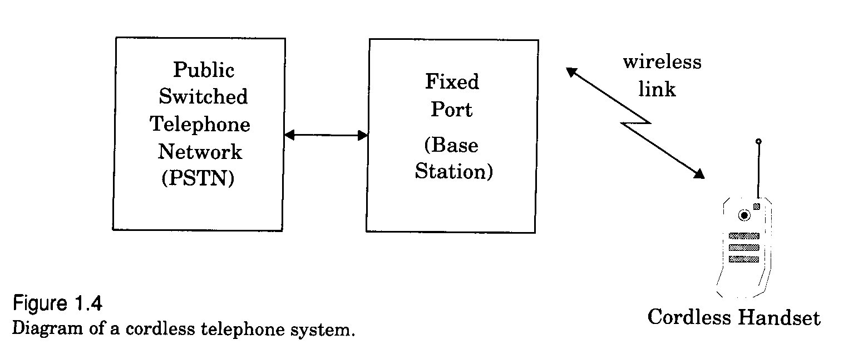
  1.4.2 Cordless Telephone Systems

Slide 16
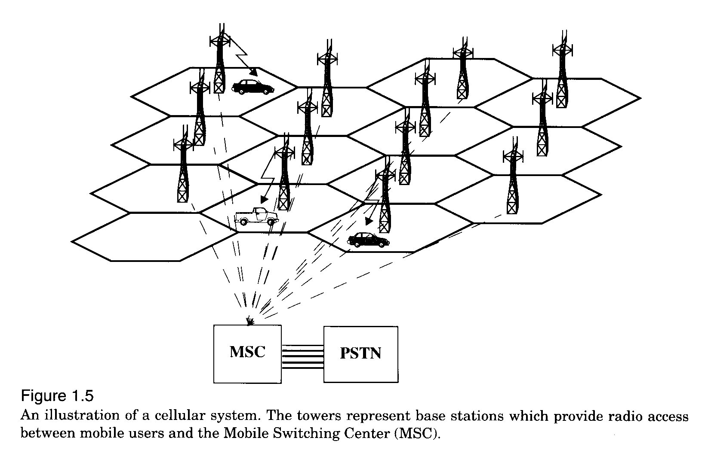
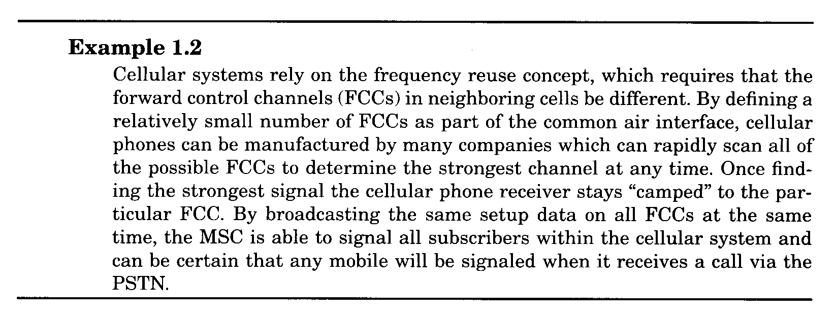
  1.4.3 Cellular Telephone Systems

Slide 17
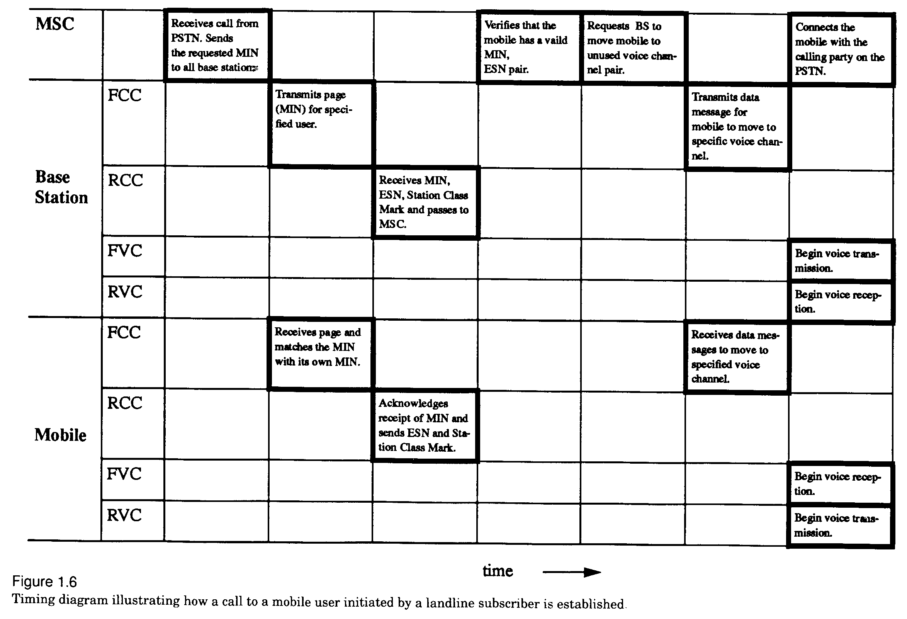
  1.4.3.1 How a Cellular Telephone Call is Made

Slide 18
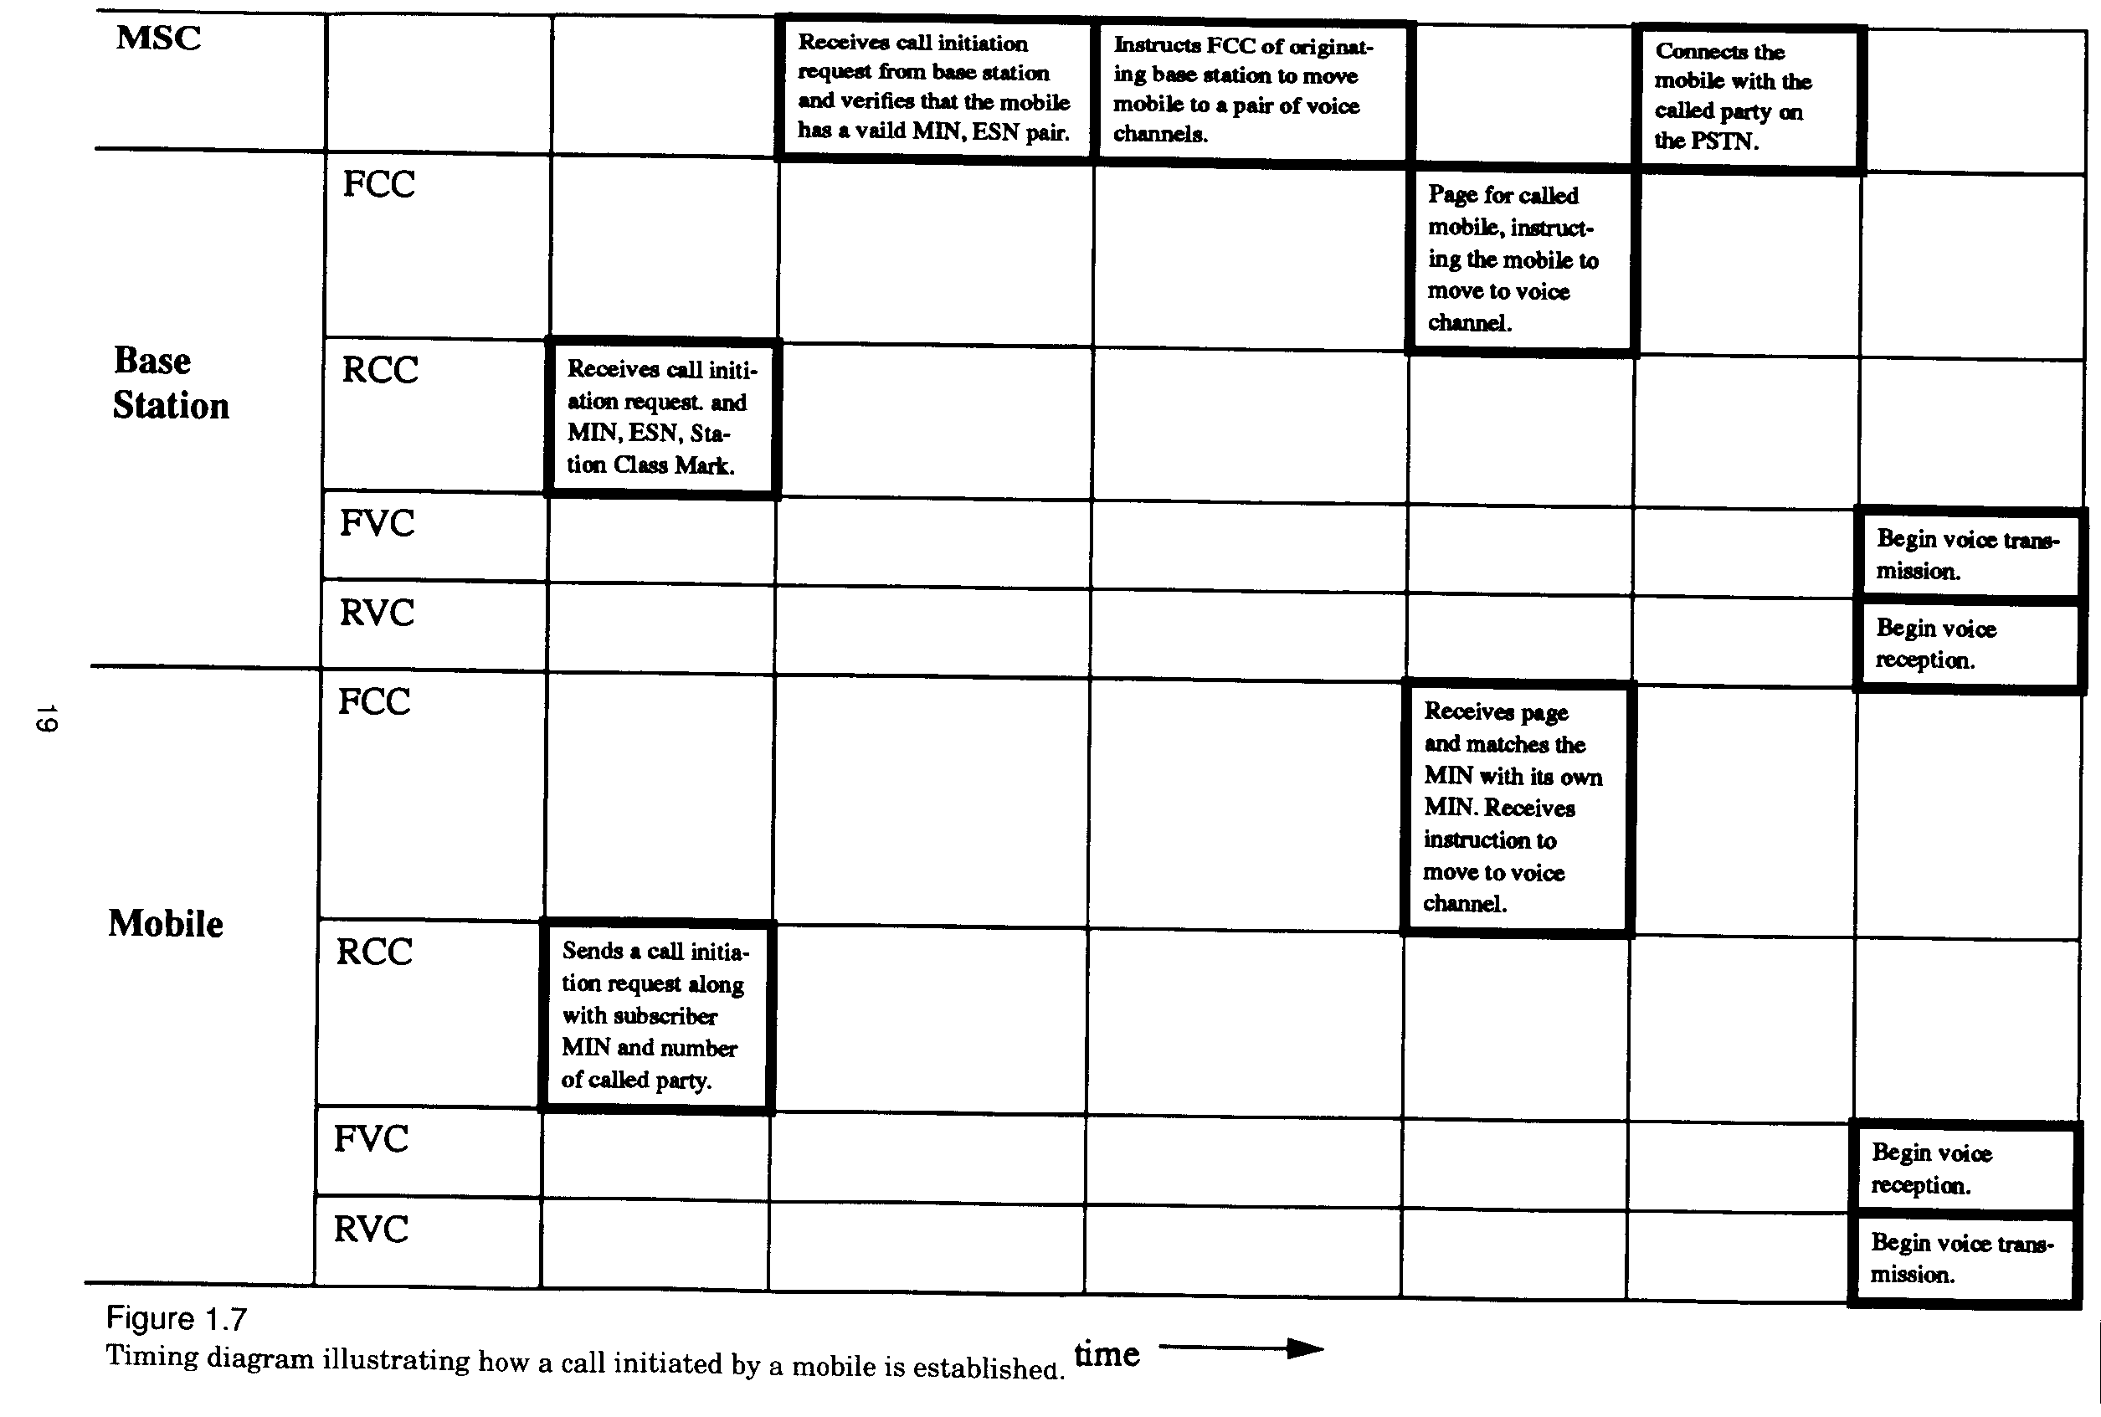

Slide 19
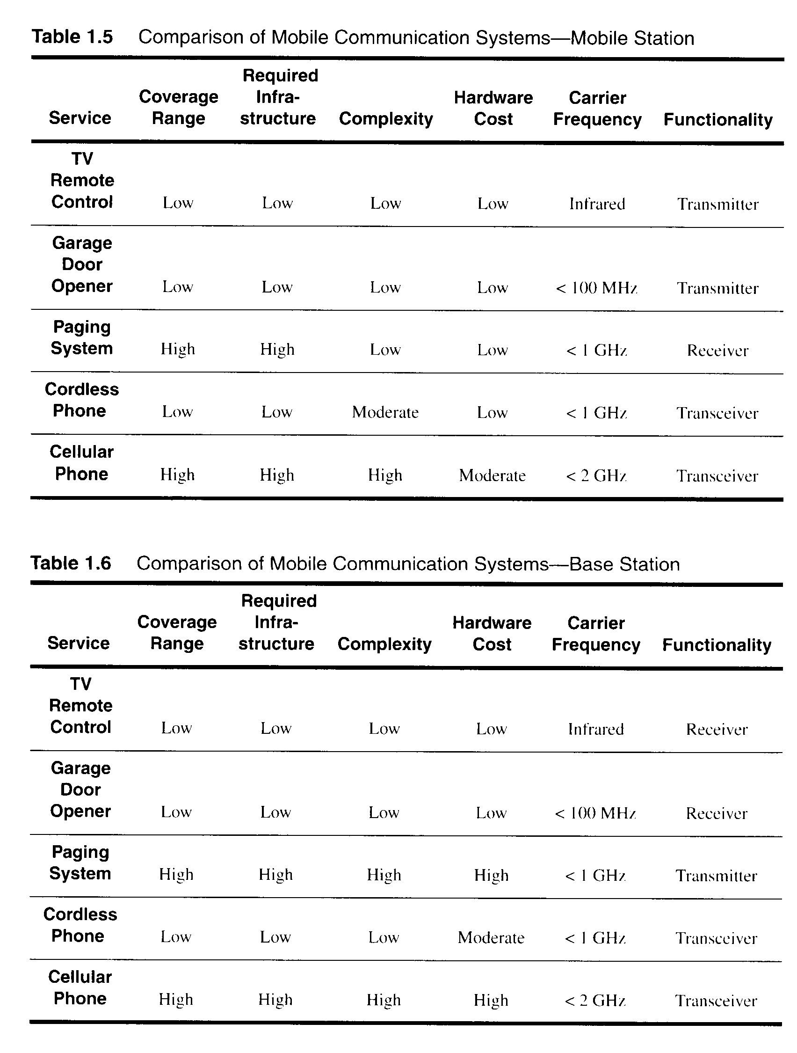
  1.4.4 Comparison of Common Mobile Radio Systems

Slide 20
1.5 Trends in Cellular Radio+Personal Comm.
Personal Communication Services (PCS) or PCN.
  voice+data (PDA)
  wireless internet services
Low earth orbit (LEO) satellite communication
Indoor Wireless Networking
  WLAN
  HyperLAN
  Bluetooth(PAN)
  BRAN
Future Public Land Mobile Telephone System (FPLMTS)---A worldwide Standard
  3G, 4G
  Software-defined Radio
Fixed Wireless Access
  WLL
  LMDS

